Slide 1
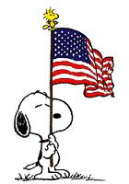

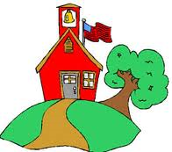
Kindergarten News
Lincoln School November 6, 2015
Happenings
School to Home
Connection
In reading we read the book Duck on a Bike and discussed the main character, setting and major events. Have your child retell you this story using beginning, middle and end.
In math we continued to work on counting and quantities. We worked with using ten frames. We also continued to work on writing our numbers 0-20. We continued our work with shapes and positional words. Please continue to practice this at home.
In science we began to learn about sun and shadows. Ask your child what 3 things they need for a shadow to be present. Ask them what they did with their shadow on the playground.
On November 23rd, the kindergarteners will gather together for our annual Feast.
Homework Ideas: (Please send it in to share after it is complete, so we can celebrate your child’s hard work!)
Write sentences using one of our high frequency words- make sure to post the list of words they made and brought home this week!
Make shadow puppets at home and trace it
Read 20 minutes each night
Write about Veteran’s day
Ask your child…
To read all our high frequency words
To tell you what the author and illustrator do
Important Dates
November 18: Turkey Trot- wear your gym shoes!
November 23: Thanksgiving Feast at 1:30
November 25-27: No School
Notes:
f

